Slide 1
MET CS 555 Foundation Machine Learning Project Presentation
Raghav Jindal
U83386066

Slide 2
Predicting Employee Attrition
Attrition is defined as a gradual but intentional reduction in staff numbers that occurs when employees leave a company and are not replaced.
The predictive analysis is performed in the following stages:
Data Understanding– understanding the data and variables that can have an impact on the prediction.
Data Exploration (EDA) – looking at categorical and numerical variables by using different plots and diagrams to make inferences about the data
Data Cleaning – imputing missing values in the data and eliminating the variables that don’t have any significance.
Data Splitting – Splitting the data set into the train (70%) and test (30%) data sets.
Model Building – using Logistic Regression

Slide 3
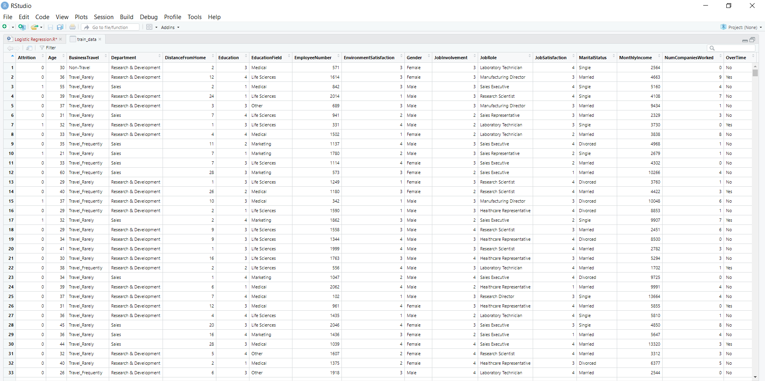
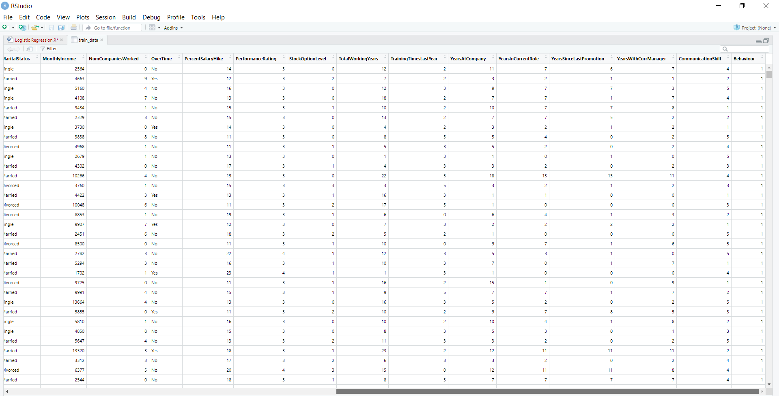
Data before cleaning

Slide 4
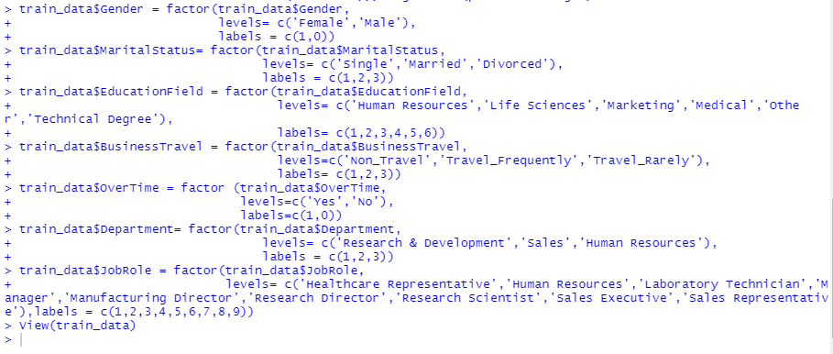
Data After Cleaning
Converting Categorical variables
Checking Null Values

Slide 5
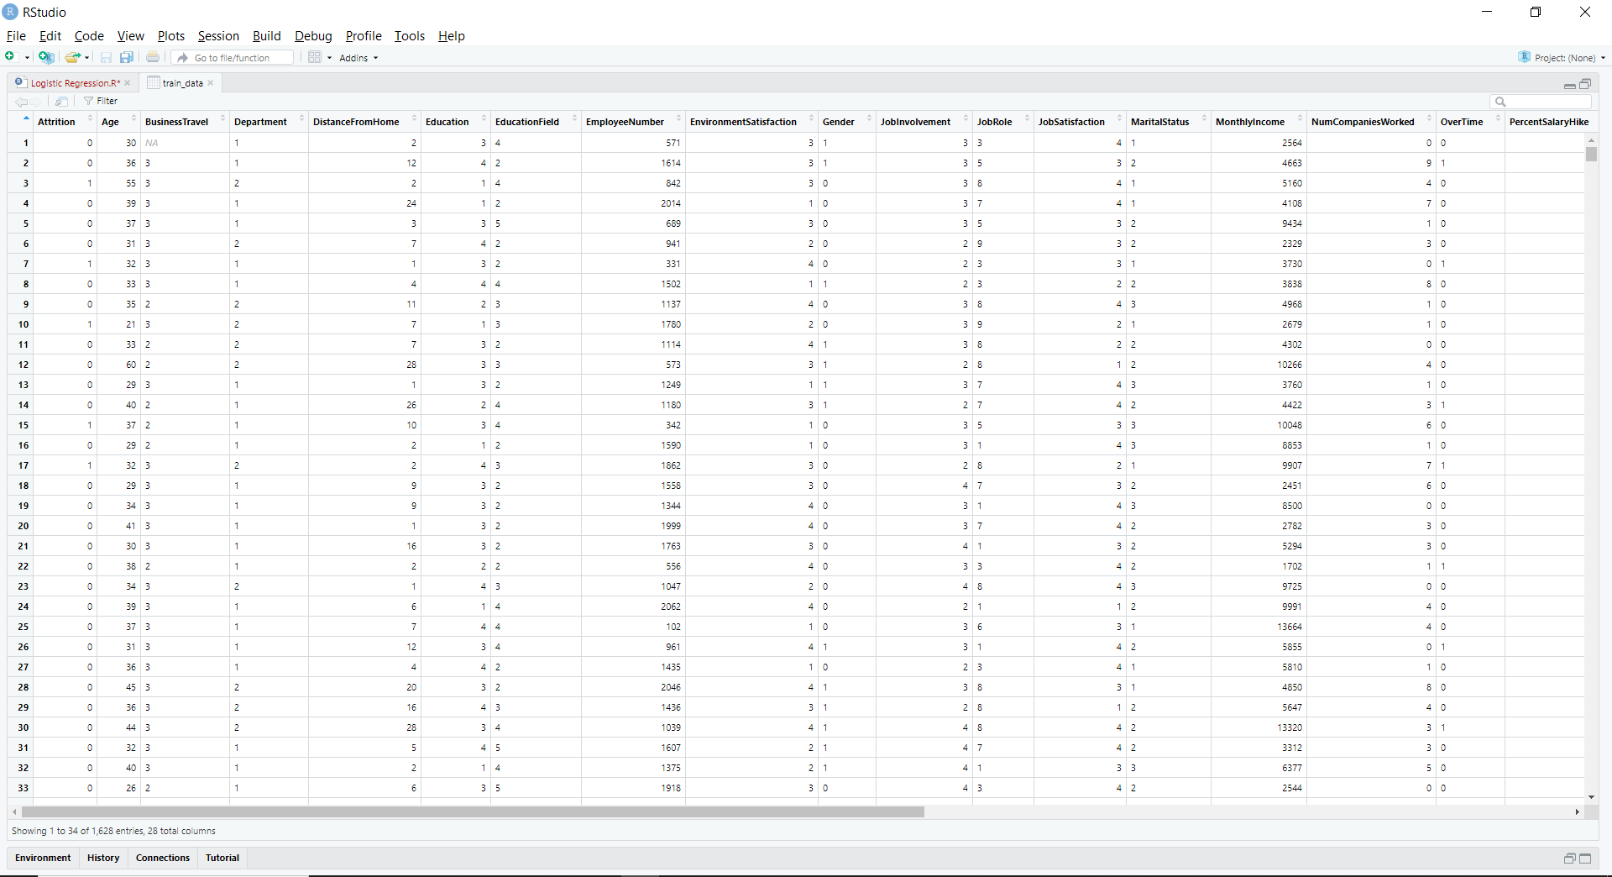

Slide 6
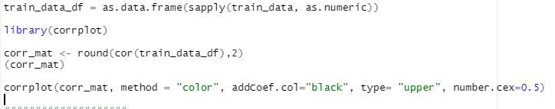
Exploratory Data Analysis
CORRPLOT

Slide 7
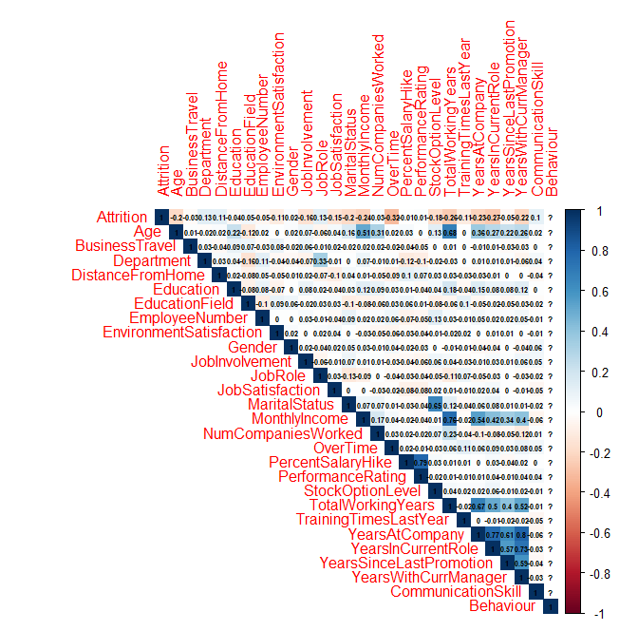

Slide 8
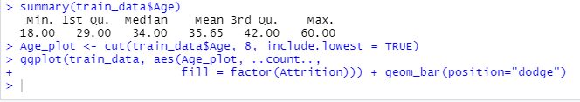
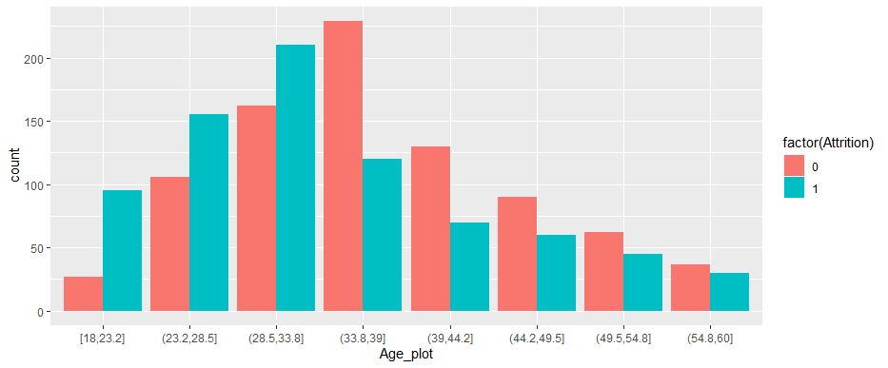
1 Age
Employees in the age group of 30-35 have leave the company more than any other age group.

Slide 9
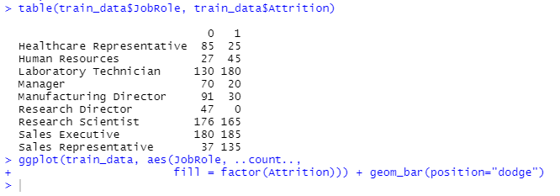
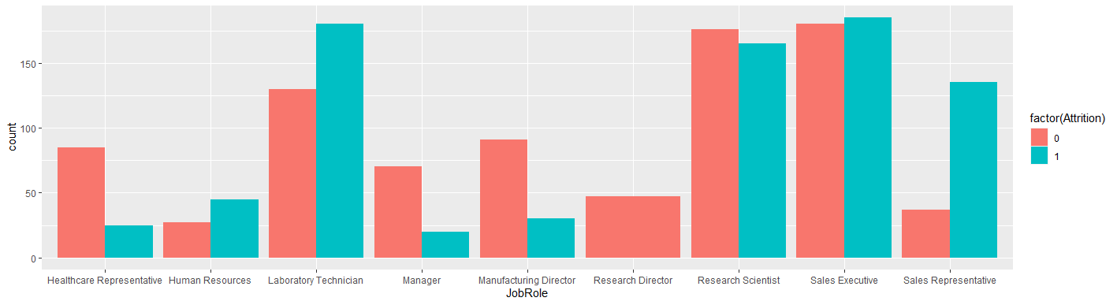
2 Job Role
Job Role of laboratory Technician and Sales Executive and Research Scientist have high attrition rate.

Slide 10
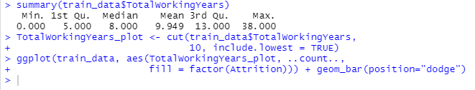
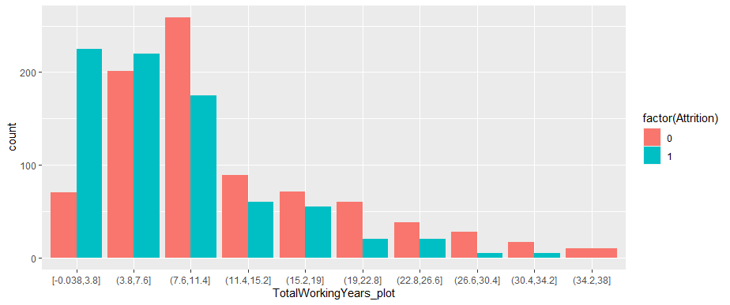
3 Total Working Years
Employees who are working in the company for a shorter span of time have been attiritioned rather than the ones who are working for longer duration

Slide 11
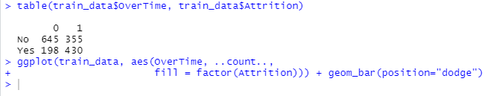
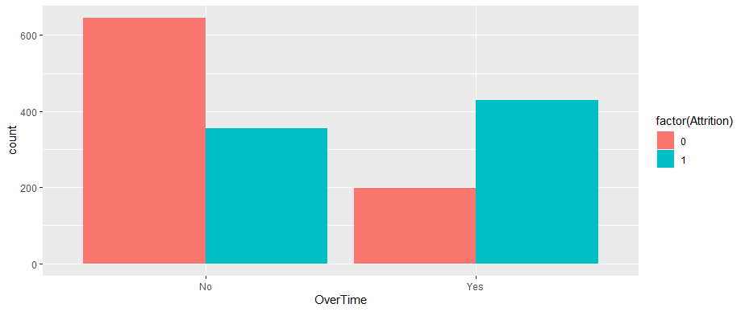
4 Overtime
From the above image it looks like employees who are not doing over time are staying with the company for longer period.

Slide 12
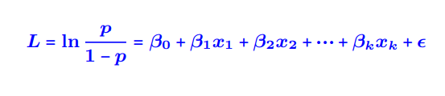
MODEL & EVALUATION (Logistic Regression)
A multiple logistic regression seeks to find an equation that best predicts the probability of a Y variable value as a function of the X variables. The independent variables can then be measured on a new individual to estimate the likelihood of it having a specific value of the dependent variable.

Slide 13




Splitting Dataset
Creating Model
Prediction

Slide 14
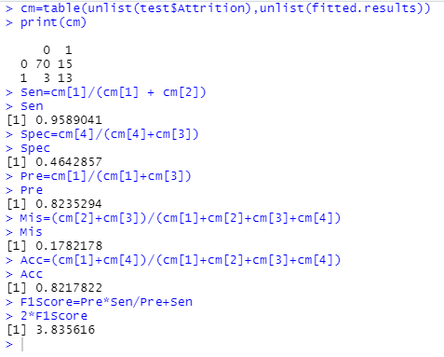
Confusion Matrix and other Metrics

Slide 15
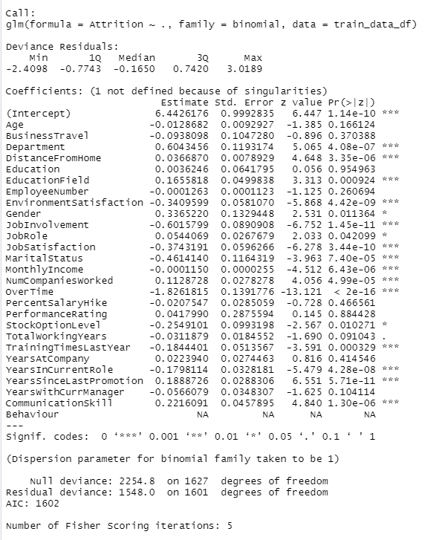
Summary Model

Slide 16
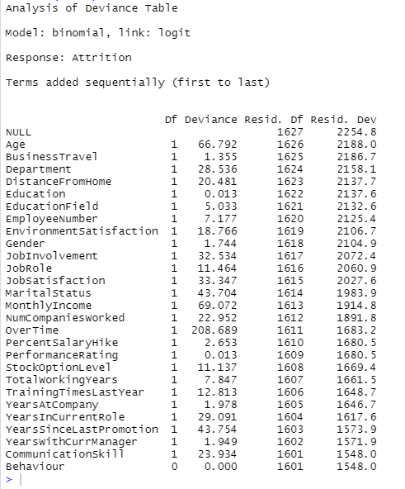
Anova Model

Slide 17
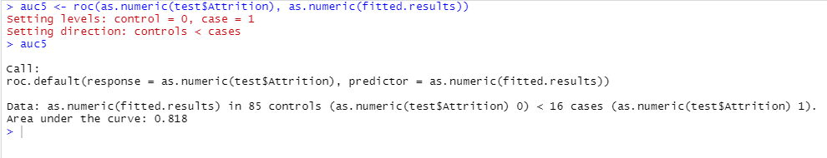
AUC- Area under the curve

Slide 18
Conclusion
I have created a very model that predicts employee attrition with an accuracy of 82.17 percent on the actual data using basic exploratory data analysis and learning models like a Logistic Regression classifier.
In order to improve our environment and reduce attrition, we recommend that we strive to concentrate on these factors going forward. The fact that sales representatives and laboratory technicians have a substantially higher coefficient for the job role factor than other positions, which indicates that they are leaving at a larger rate than other positions, is another major problem that we identified. If everything else is constant, we suggest digging deeper into the reasons why people are leaving these jobs at a higher rate and simultaneously apply different models and check the accuracy of those.

